Slide 1

VTHT 1491
Special Topics
Acid base balance

Slide 2
Acid – Base balance is an important hemostatic mechanism in the body
Measured by pH
pH is a mathematical value representing the negative logarithm of the hydrogen ion (H⁺) concentration.
More H⁺ = more acidic = lower pH
Less H⁺ = more basic = higher pH
Normal pH of blood = 7.35 – 7.45
    Slightly alkaline
< 7.35 = acidosis > 7.45 = alkalosis

Slide 3
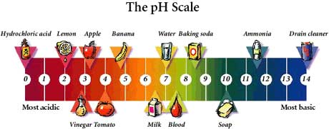

The pH Scale
An acid is any substance that increases the H+ (Hydrogen ion) concentration of a solution and decreases the pH.
A base is any substance that reduces the H+ concentration of a solution and increases the pH.
A minor deviation from the normal range can severely affect many organs.

Slide 4
Mechanisms that regulate pH are either respiratory or metabolic in nature and are maintained by three systems:
Chemical Buffers
  Bicarbonate (carbonic acids)
  Phosphate (RBCs, kidneys)
  Hemoglobin
Respiratory System
  By breathing and altering CO₂ the lungs can regulate the concentration of carbonic acid.
Renal System
  Elimination of excess acids or bases

Slide 5
Categories of acid-base Disturbances
Acidosis: results from accumulation of acid or depletion of alkaline reserve (bicarbonate) in blood. Characterized by increase in H⁺ ion concentration.
Alkalosis: results from loss of acid without comparable loss of base in body fluids. Characterized by decreased H⁺ ion concentration.
Metabolic: caused by an imbalance in the production of acids or bases and their excretion by the kidneys.
Respiratory: caused primarily by changes in carbon dioxide exhalation due to lung or breathing disorders.

Slide 6

Metabolic Acidosis
Acidosis resulting from accumulation of ketones or lactic acids in the blood, at the expense of bicarbonate, thus diminishing the body’s ability to neutralize acids.
Common causes include:
  Diarrhea – loss of sodium bicarbonate
  Ketosis – starvation or diabetes
  Severe infectious diseases – septicemia
  Renal insufficiencies
  Administration of acidic drugs (antibiotics)
  Shock

Slide 7
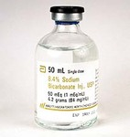
Treatment for Metabolic Acidosis
For mild imbalance, give an alkalinizing IV solution (containing lactate or acetate)
For severe imbalances, treat with sodium bicarbonate IV.
  Should be given slowly (over 15 to 30 minutes)
  Deaths have occurred during fast administration of sodium bicarbonate in dehydrated animals.

Slide 8

Respiratory Acidosis
CO₂ production is greater than CO₂ excretion.
  Increased CO₂ = gain in acids = decreased pH
Caused by anything that depresses ventilation (hypoventilation) and impairs excretion of CO₂ such as:
  Deep anesthesia
  Pulmonary disease
  Respiratory obstruction
  Pneumonia
Clinical signs:
  Hypertension (increased cardiac output)
  Vasodilation
  Ventricular arrhythmia
  Hypoxia
  Coma

Slide 9
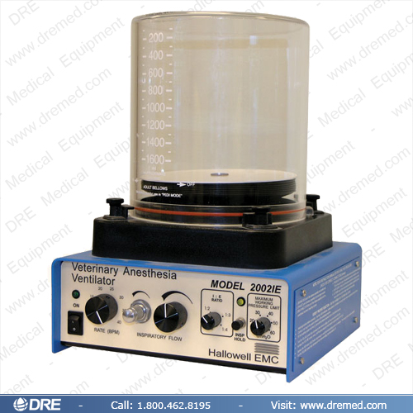
Treatment for Respiratory Acidosis
Treatment of underlying disease (e.g. pneumonia)
If anesthesia related, ventilate patient with a higher volume/rate of O₂ than what the patient was breathing to help remove some of the CO₂
Natural compensation of the body with time through the kidneys (although chronic hypercapnia is rare)

Slide 10

Metabolic Alkalosis
Disturbance in which acid-base status shifts toward alkaline due to:
  uncompensated loss of acids
  ingestion or retention of excess base
  potassium depletion
Caused by:
  Vomiting
  increased renal absorption
  of bicarbonate (HCO₃)
  Diuretic therapy

Slide 11
Treatment for Metabolic Alkalosis
Natural compensation through the respiratory system by hypoventilation, resulting in a mild respiratory acidosis.
If severe enough, metabolic alkalosis should be treated by replacing the missing element
  Potassium replacement if patient is hypokalemic
  Chloride replacement may be necessary in vomiting patient.

Slide 12

Respiratory Alkalosis
Reduced CO₂ tension in the ECF caused by excessive excretion of CO₂ through the lungs (hyperventilation → hypocapnia)
  Excessive controlled ventilation
Conditions commonly associated with respiratory alkalosis include:
  Pain/excitement (stimulation of spontaneous hyperventilation)
  Hypoxia
  Fever
  Poisoning
  CNS disease
  Pulmonary embolism/edema
  High environmental temperatures

Slide 13
Clinical Signs and Treatment for Respiratory Alkalosis
Clinical signs may include tachycardia and ECG abnormalities.
Natural compensation of the body with time through the kidneys may occur (rare)
Respiratory alkalosis can be treated by:
  Decreasing the volume of O₂ being administered if patient is being ventilated.
  If patient is breathing spontaneously, assess and treat the cause of hyperventilation (e.g. light anesthesia or pain).

Slide 14

Fluid Therapy and Acid-Base Imbalances
We cannot understand or treat imbalances of water (fluids), electrolytes, and acid-base balance in isolation from each other because each of these frequently affects the other two.
Primary electrolytes of body include sodium, potassium, chloride, phosphate, and bicarbonate.
  Primary cation of ICF = K+
  Primary anion of ICF = Ph-
  Primary cation of ECF = Na+
  Primary anion of ECF = Cl-
Should all be kept in a constant state of balance.

Slide 15

Relationships among fluid, electrolyte, and acid-base imbalances.
Cause | Potential Effect | Reason
Hypovolemia | Alkalosis | More Na+ is reabsorbed by kidneys while more H+ is secreted; pH of ECF increases
Hypervolemia | Acidosis | Less Na+ is reabsorbed and decreased H+ is secreted into renal tubules; H+ retained in ECF causes acidosis (decreased pH)

Slide 16
Correction of Acidosis with Fluid Therapy (Ringer’s Lactate Solution)
Acidosis is commonly treated with Ringer’s Lactate solution which includes:
  Sodium (Na+) to rebuild ECF volume
  Potassium (K+) to rebuild ICF volume
  Lactate to balance cations
  Just enough glucose to make solution isotonic
Ringer’s Lactate must be administered very cautiously with close monitoring of blood pH to avoid causing a pH imbalance opposite of the one that was meant to be coreected.
Too much Ringer’s Lactate can cause alkalosis

Slide 17
Correction of Alkalosis with Fluid Therapy (KCl)
Alkalosis is commonly treated using potassium chloride (KCl).
KCl must be administered very carefully because potassium ions can cause painful venous spasms
Even a small potassium excess can lead to cardiac arrest
High potassium solutions should never be given to patients in renal failure or with unknown renal status because absence of renal excretion of potassium can bring on lethal hyperkalemia.

Slide 18
Other relationships among fluid, electrolyte and acid-base imbalances:
Cause | Potential Effect | Reason
Acidosis | Hyperkalemia | H+ diffuses into cells and displaces K+; K+ leaves ICF, K+ concentration in ECF increases
Hyperkalemia | Acidosis | Opposite from above
Alkalosis | Hypokalemia | H+ diffuses from ICF to ECF. More K+ remains in the ICF to compensate for the H+ loss, causing drop in ECF K+
Hypokalemia | Alkalosis | Opposite from above
Acidosis | Hyperhloremia | More Cl- is excreted as ammonium chloride to buffer excess acid in renal tubules, leaving less Cl- in the ECF.
Hyperchloremia | Acidosis | More H+ is retained in blood to balance excess Cl-, causing hyperchloremic acidosis

